Slide 1

2026 AI Construction Trends: 25+ Experts Share Insights
Week of February 16
Jacob Appling

Slide 2
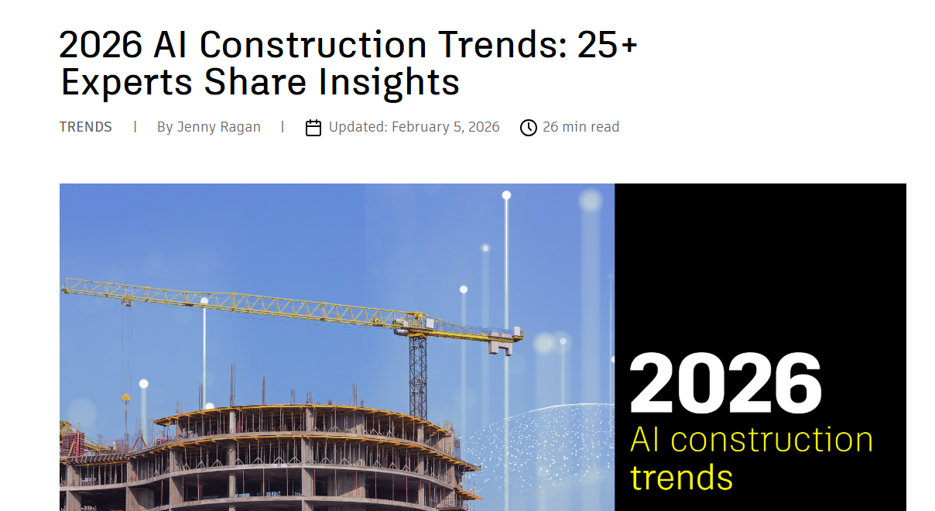
Article #4 (Row 4 via Google Sheet)

Slide 3
Link to the Source
https://www.autodesk.com/blogs/construction/2026-ai-trends-25-experts-share-insights/

Slide 4
Main Findings
AI Is Moving From Hype to Reality
The article opens by noting that AI has shifted past buzzword status and is becoming a real, operational force in construction workflows.
While only ~32% of construction leaders feel they’re close to their AI goals, most agree AI adoption will continue to grow.
Experts Identify Key AI Trends for 2026
Industry leaders shared insights on how AI will impact construction, including:
• Democratization and Accessibility
AI tools will become more standardized and widely used across organizations, enabling even smaller firms to benefit.
• Routine Task Automation
AI will handle repetitive work like summarizing documents, generating meeting recaps, organizing punch lists, and updating schedules, freeing human teams to focus on decisions.
• Embedded Workflow Intelligence
Rather than existing as standalone tools, AI features will be embedded across planning, design, and execution workflows, offering deeper insight and consistency.
• Predictive Capabilities
AI will help identify risks (schedule, procurement, coordination) before they occur, improving project certainty and decision-making.
• Spatial and Contextual Intelligence
AI systems tied to visual and spatial data (e.g., reality capture) will bring better real-world insight into field conditions, bridging digital plans and onsite reality.
• Expansion Across Lifecycle Phases
From generative design and risk analysis to safety monitoring and quality control (e.g., drone/LiDAR checks), AI will influence nearly every stage of a project.
• Integration With Broader Digital Ecosystems
AI will help unify data across design tools, supply chain information, facilities management, and real estate analytics.
• Human-AI Partnership
A recurring view is that AI augments rather than replaces human expertise, acting as a “co-pilot” for professionals while preserving judgment and accountability.
Diverse Perspectives
Some contributors emphasize major transformation and competitive advantage from AI, while a few remain cautious, urging realistic expectations and attention to legal, ethical, and data privacy concerns.

Slide 5
Broader implications for society
Workforce Transformation
AI is expected to shift the nature of work, eliminating low-value tasks while emphasizing decision-making, problem-solving, and strategic thinking.
This may help address labor shortages and enhance productivity across sectors, though it also raises questions about skills evolution, retraining, and workforce equity.
Data Ethics and Governance
As AI becomes embedded in critical workflows, concerns around data privacy, transparency, security, and legal liability gain prominence.
Broader society will need frameworks to ensure ethical use, accountability, and trust in AI systems.
Efficiency and Decision Quality
AI’s capacity to analyze massive datasets quickly could positively influence industry productivity, sustainability goals, and economic efficiency—benefitting communities by reducing project delays, waste, and cost overruns.
Digital Divide Considerations
There’s an implied risk that firms not investing in AI may lag behind, potentially widening gaps between technology adopters and laggards, which may influence employment and market competitiveness.

Slide 6
Relevance and potential influence on the construction industry
Operational Baseline Shift
2026 is described as the year when AI becomes an industry baseline, not a future trend—meaning adoption may become essential for competitiveness.
Risk, Quality, & Safety Improvements
AI’s predictive analysis and real-time monitoring promise fewer delays, improved safety conditions, and reduced rework, directly impacting project delivery and jobsite outcomes.
Enhanced Project Coordination & Insight
By centralizing and interpreting data across tools and teams, AI can boost visibility, coordination, and insight, leading to smarter planning and faster decision cycles.
Cost & Time Savings
Automated tasks such as takeoffs, document summarization, and clash detection could significantly reduce manual labor and human error, improving cost control and schedule reliability.
Expanded Role Across the Value Chain
AI’s influence will extend beyond construction execution into facilities management, real estate forecasting, and lifecycle asset performance, creating new strategic opportunities for firms.
Overall Takeaway
In 2026, AI in construction will no longer be experimental—it will be practical, integrated, and mission-critical, reshaping how projects are planned, built, and managed. Firms that adopt and govern AI responsibly stand to gain operational advantages, improve outcomes, and help redefine the industry’s future.

